Slide 1
Object Oriented Programming with Python

Slide 2
What are Objects?
An object is a location in memory having a value and possibly referenced by an identifier.
In Python, every piece of data you see or come into contact with is represented by an object.

Slide 3
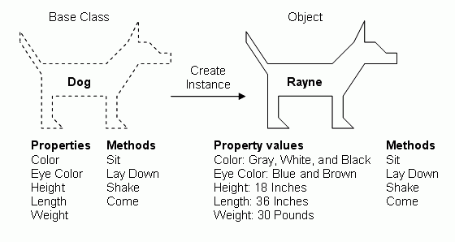
Defining a Class

Slide 4
Defining a Class
Python’s class mechanism adds classes with a minimum of new
syntax and semantics.
It is a mixture of the class mechanisms found in C++ and Modula- 3.
As C++, Python class members are public and have Virtual Methods.

Slide 5
Defining a Class
As we know how to create a Function.
Create a function in class MyClass named func().
Save this file with extension .py
You can create object by invoking class name.
Python doesn’t have new keyword
Python don’t have new keyword because everything in python is an object.

Slide 6
Defining a Class
class Employee:
'Common base class for all employees‘
empCount = 0
4.
5.
6.
7.
def init (self, name, salary): self.name = name self.salary = salary Employee.empCount += 1
8.
9.
def displayCount(self):
print("Total Employee %d" % Employee.empCount)
10.
11.
def displayEmployee(self):
print("Name : ", self.name, ", Salary: ", self.salary)

Slide 7
Defining a Class
The first method init () is a special method, which is called class constructor or initialization method that Python calls when you create a new instance of this class.
Other class methods declared as normal functions with the exception that the first argument to each method is self.
Self: This is a Python convention. There's nothing magic
about the word self.
The first argument in init () and other function gets is used to refer to the instance object, and by convention, that argument is called self.

Slide 8
Creating instance objects
2
"This would create first object of Employee class"
emp1 = Employee("Zara", 2000 )
"This would create second object of Employee class"
emp2 = Employee("Manni", 5000)
To create instances of a class, you call the class using class name and
pass in whatever arguments its init method accepts.
During creating instance of class. Python adds the self argument to the list for you. You don't need to include it when you call the methods
emp1.displayEmployee()
emp2.displayEmployee()
print "Total Employee %d" % Employee.empCount

Slide 9
Special Class Attributes in Python
Except for self-defined class attributes in Python, class has some special attributes. They are provided by object module.
Attributes Name | Description
dict | Dict variable of class name space
doc | Document reference string of class
name | Class Name
module | Module Name consisting of class
bases | The tuple including all the superclasses

Slide 10
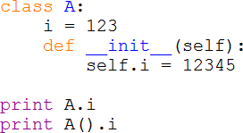

Form and Object for Class
Class includes two members: form and object.
The example in the following can reflect what is the difference between object and form for class.
Invoke form: just invoke data or method in the class, so i=123
Invoke object: instantialize object Firstly, and then invoke data or Methods.
Here it experienced init (), i=12345

Slide 11
Class Scope
Another important aspect of Python classes is scope.
The scope of a variable is the context in which it's visible to the program.
Variables that are available everywhere (Global Variables)
Variables that are only available to members of a certain class (Member variables).
Variables that are only available to particular instances of a class (Instance variables).

Slide 12
Destroying Objects (Garbage Collection):
Python deletes unneeded objects (built-in types or class instances) automatically to free memory space.
An object's reference count increases when it's assigned a
new name or placed in a container (list, tuple or dictionary).
The object's reference count decreases when it's deleted
with del, its reference is reassigned, or its reference goes out of scope.
You normally won't notice when the garbage collector destroys an orphaned instance and reclaims its space
But a class can implement the special method any non-memory
resources used by an instance.

Slide 13
Destroying Objects (Garbage Collection):
a = 40 # Create object <40>
b = a # Increase ref. count of <40> c = [b] # Increase ref. count of <40>
del a # Decrease ref. count of <40>
b = 100 # Decrease ref. count of <40> c[0] = -1 # Decrease ref. count of <40>

Slide 14
Class Inheritance:
Instead of starting from scratch, you can create a class by deriving it from a preexisting class by listing the parent class in parentheses after the new class name.
Like Java subclass can invoke Attributes and methods in superclass.
Syntax
class SubClassName (ParentClass1[, ParentClass2, ...]): 'Optional class documentation string' class_suite
Python support multiple inheritance but we will only
concern single parent inheritance.

Slide 15
class Parent: # define parent class parentAttr = 100
def init (self):
print "Calling parent constructor“
def parentMethod(self):
print 'Calling parent method‘ def setAttr(self, attr):
Parent.parentAttr = attr def getAttr(self):
print "Parent attribute :" ,
Parent.parentAttr
class Child(Parent): # define child class def init (self):
print "Calling child constructor"
def childMethod(self):
print 'Calling child method'
c = Child() # instance of child c.childMethod() # child calls its method c.parentMethod() # calls parent's method c.setAttr(200) # again call parent's method c.getAttr() # again call parent's method
Static Variable
Output
Calling child constructor Calling child method Calling parent method Parent attribute : 200

Slide 16
Overriding Methods:
You can always override your parent class methods.
One reason for overriding parent's methods is because you
may want special or different functionality in your subclass.
class Parent: # define parent class def myMethod(self):
print 'Calling parent method' class Child(Parent): # define child class
def myMethod(self):
print 'Calling child method'
c = Child() # instance of child
c.myMethod() # child calls overridden method

Slide 17
Method Overloading
In python method overloading is not acceptable.
This will be against the spirit of python to worry a lot about what types are passed into methods.
Although you can set default value in python which will be a better way.
Or you can do something with tuples or lists like this…
def print_names(names):
"""Takes a space-delimited string or an iterable""" try:
for name in names.split(): # string case print name
except AttributeError:
for name in names:
print name

Slide 18
Polymorphism:
Polymorphism is an important definition in OOP. Absolutely, we can realize polymorphism in Python just like in JAVA. I call it “traditional polymorphism”
In the next slide, there is an example of polymorphism in Python.
But in Python,
Only traditional polymorphism exist?

Slide 19
Polymorphism:
class Animal:
def init (self, name): # Constructor of the class
self.name = name
def talk(self): # Abstract method, defined by convention only raise NotImplementedError("Subclass must implement
abstract method")
class Cat(Animal):
def talk(self):
return 'Meow!' class Dog(Animal):
def talk(self):
return 'Woof! Woof!'
animals = [Cat('Missy'), Cat('Mr. Mistoffelees'), Dog('Lassie')] for animal in animals:
Print(animal.name + ': ' + animal.talk())

